Slide 1


.
SRM INSTITUTE OF SCIENCE AND TECHNOLOGY
COLLEGE OF ENGINEERING AND TECHNOLOGY
DEPARTMENT OF NETWORKING AND COMMUNICATIONS
21CSC202J-Operating Systems , Mini-Project Presentation
Dining Philosopher problem.
Reg No: RA2211031010160
Reg No: RA2211031010181

Slide 2
Table of contents
Objective
Problem Statement
Architecture/ Flow chart
Hardware/Software requirements
Implementation- Code snippet
Results- Screen Shots of Output
Conclusion

Slide 3
Objective:
The Dining Philosophers problem is a classic example in operating system often used to illustrate synchronization issues and solutions in concurrent algorithm design. It illustrates the challenges of avoiding a system state where progress is not possible, a deadlock.
Dining Philosophers problem deals with resource allocation.
Philosophers --→ Processes.
Chopstick ---→ Resource.

Slide 4
Problem Statement:
"Consider a dining hall with a circular dining table surrounded by five chairs. In the center of the table, there are five plates of spaghetti, and five forks are placed between the plates. The dining hall is occupied by five philosophers who spend their time thinking and eating.
The life of a philosopher consists of alternating periods of thinking and eating. However, a philosopher needs two forks to eat. The forks are shared with the neighboring philosophers. If a philosopher cannot acquire both forks, they will not be able to eat and must continue thinking.
> Chopsticks are limited.
> 5 – Philosophers , 5 – Chopsticks but each of them need 2 Chopsticks.

Slide 5
Possible Solution:
Allow at most four philosophers to be sitting simultaneously at the table.
Allow a philosopher to pick up his chopsticks only if both chopsticks are available (to do this he must pick them up in a critical section).
Use an asymmetric solution; that is, an odd philosopher picks up first his left chopstick and then his right chopstick, whereas an even philosopher picks up his right chopstick and then his left chopstick.

Slide 6

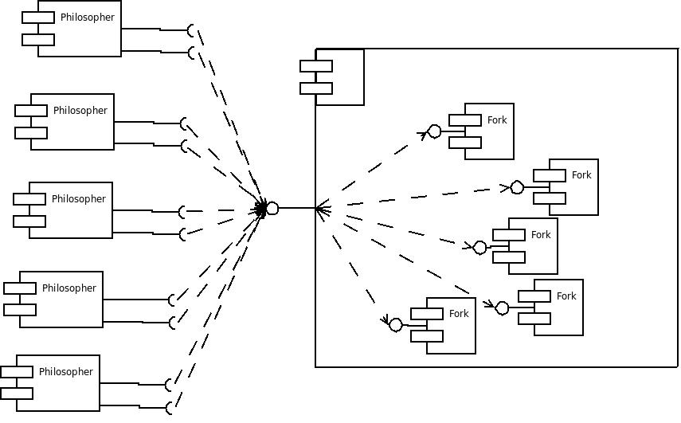
Architecture/ Flow chart:

Slide 7
Hardware/Software requirements:
Software Requirements:
Hardware Requirements:
Programming Language.
Concurrency Libraries.
Development Environment.
Operating System.
Processor.
Memory.
Storage.

Slide 8
Conclusion:
In conclusion, the Dining Philosophers problem is a classic illustration of challenges in concurrent programming, emphasizing the importance of synchronization and resource management. The problem highlights the delicate balance required to allow multiple processes (philosophers) to share resources (forks) without encountering issues like deadlock or contention.
Addressing the Dining Philosophers problem necessitates thoughtful design and implementation, typically involving synchronization mechanisms such as semaphores or mutexes. The solution should enable philosophers to alternate between thinking and eating while efficiently sharing resources in a fair and deadlock-free manner.

Slide 9


